Slide 1
Progress report
Speaker: Geng-Yun Tien
Advisor: Eric Y. Chuang
Date: 2023/10/06

Slide 2
Works
1
Finish SimCLR model training
2
Reshape the patch size into 512*512 pixel and use trained tissue type classification model to classify tumor patch (reduce patch number)
3
Inception v3 model and Densenet121 model script
4
Prepare big lab meeting paper presentation

Slide 3
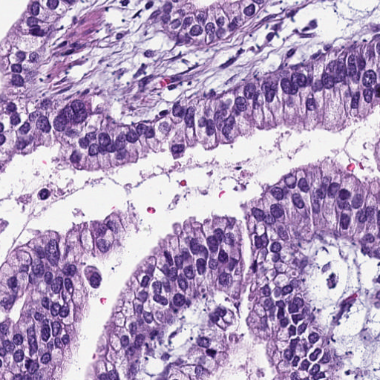
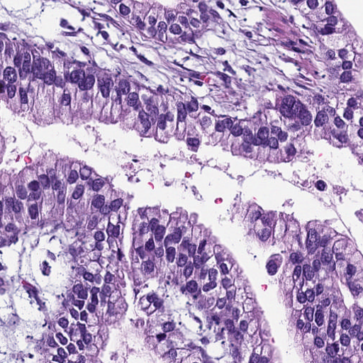
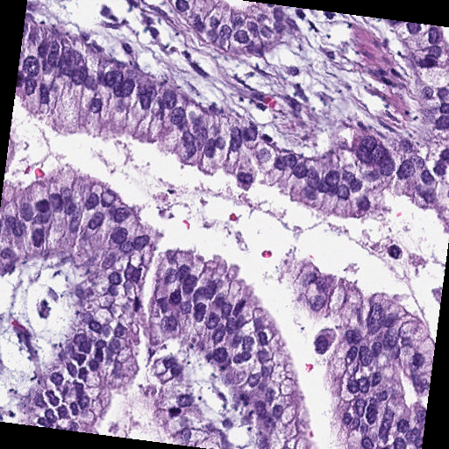
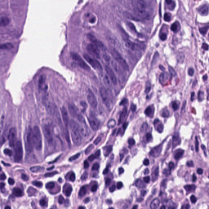
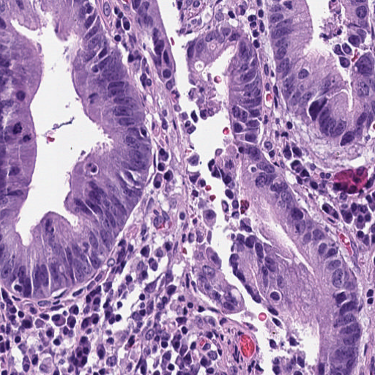
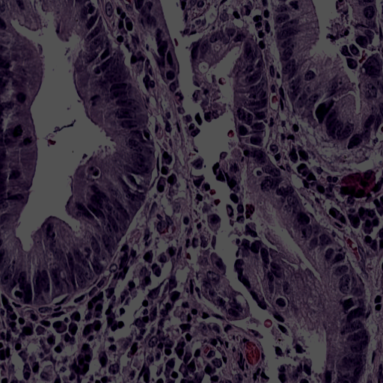
Data augmentation
Representation
Embedding
ResNet-50
……
MLP
……
Maximize
similarity
Pic.1
ResNet-50
……
MLP
……
Minimize
similarity
ResNet-50
……
MLP
……
Maximize
similarity
Pic.2
ResNet-50
……
MLP
……

Slide 4
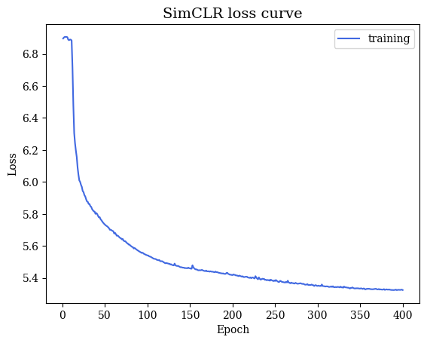
SimCLR model training result
Encoder: ResNet50
Projection: nonlinear MLP
Batch size = 500, epoch = 400, learning rate = 0.5, weight decay = 1e-4
Optimizer that I use is adamW also with linear warmup and cosine annealing after 40 epoch
nn.DataParallel was used to utilize multiple GPUs

Slide 5
KRAS gene mutation prediction - Inception v3
testing | Accuracy | Sensitivity | Specificity | AUC
Results | 0.5282 | 0.5501 | 0.5056 | 0.5279
training | Accuracy | Sensitivity | Specificity | AUC
Results | 0.8798 | 0.895 | 0.8657 | 0.8803
KRAS gene mutation prediction – Densenet121
testing | Accuracy | Sensitivity | Specificity | AUC
Results | 0.5232 | 0.5778 | 0.4523 | 0.5224
training | Accuracy | Sensitivity | Specificity | AUC
Results | 0.9166 | 0.9354 | 0.8992 | 0.9173

Slide 6
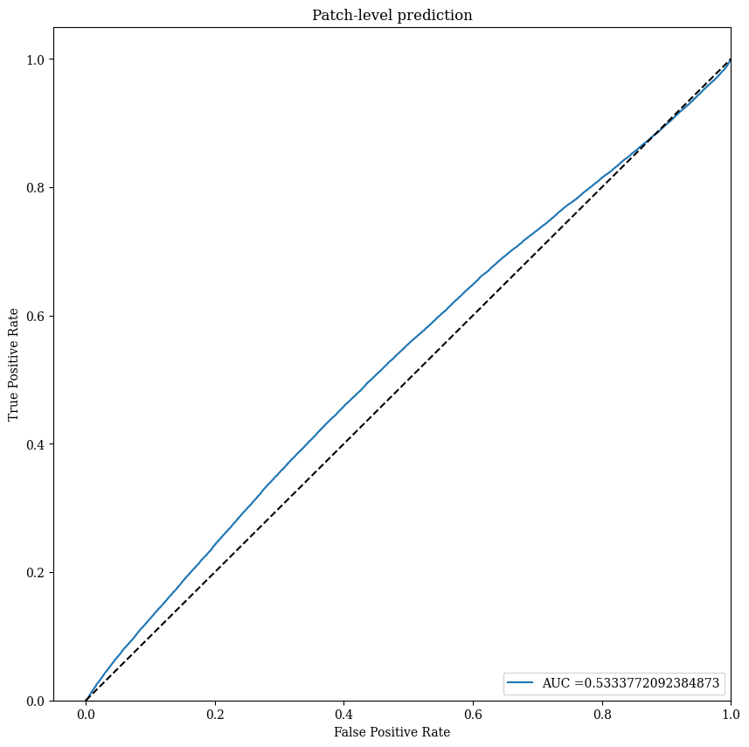
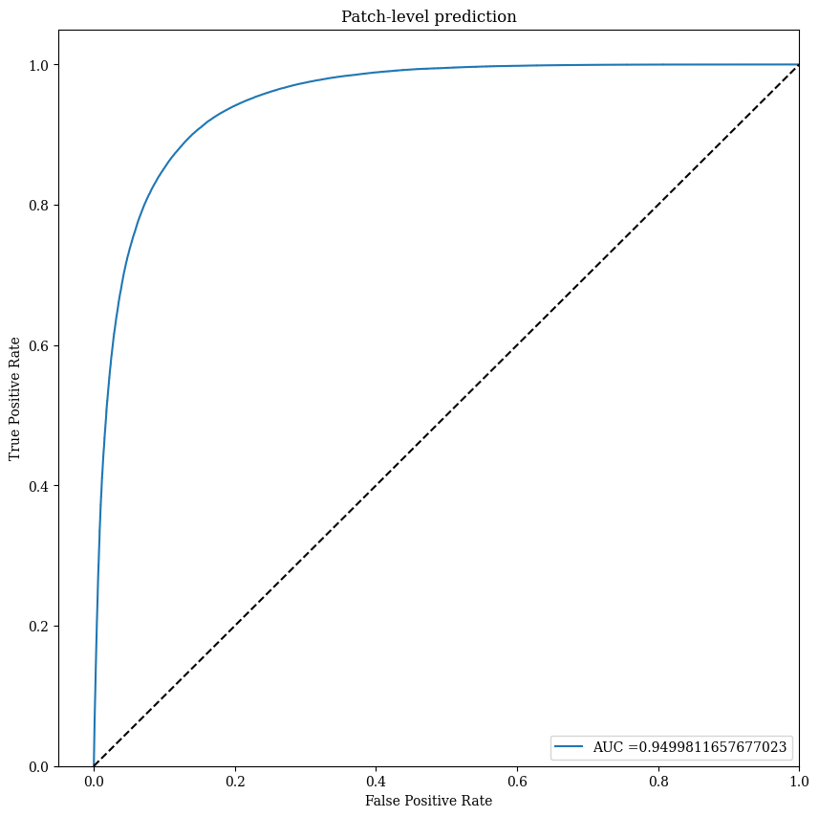
KRAS gene mutation prediction – Inception v3

Slide 7
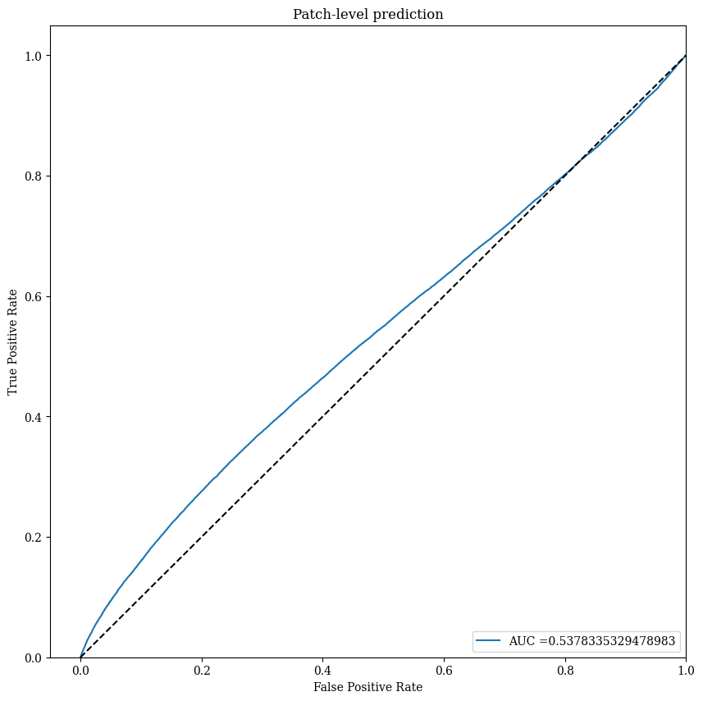
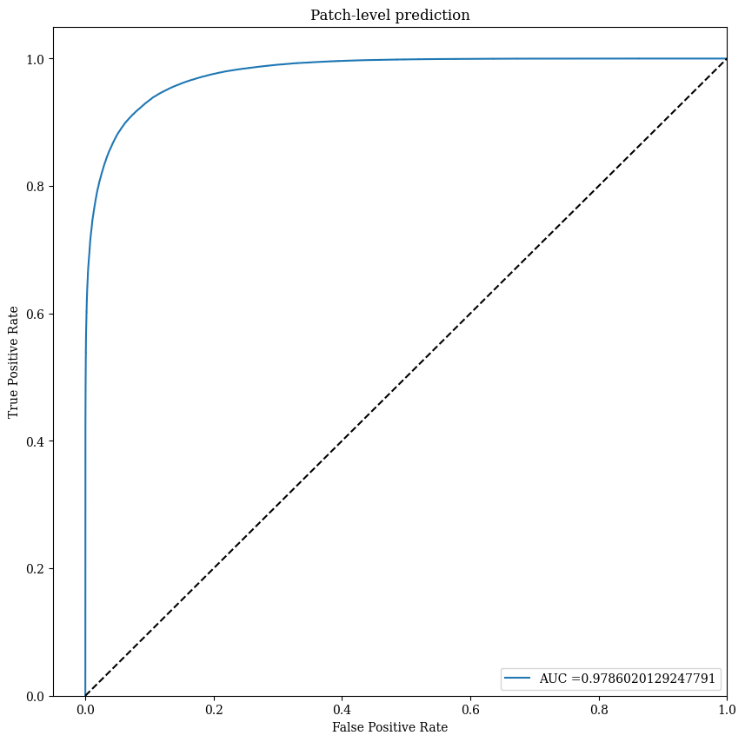
KRAS gene mutation prediction – Densenet121

Slide 8

Future work
1
Decide how to do slide level prediction
2
Single task vs. multiple task training

